Slide 1
What is Atmospheric Pressure?

Slide 2
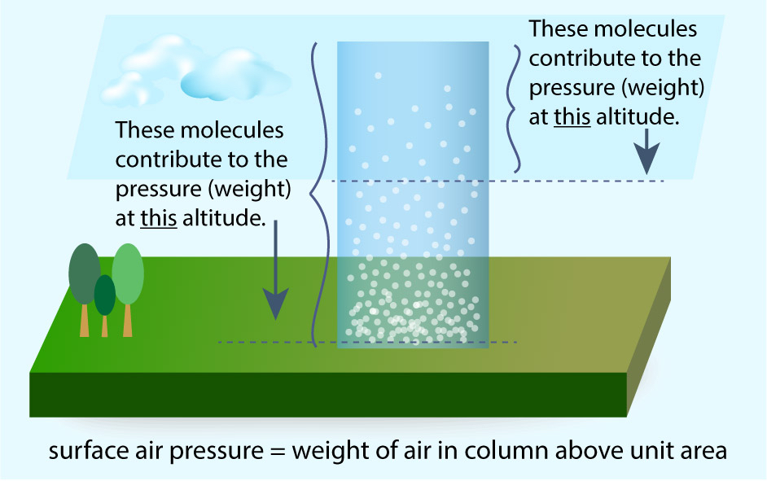
Air Pressure
Pressure is a measure of the force of an object against a surface.
The force of air against an object on the ground or in the atmosphere is a result of gravity “pulling” on the air above that object.
You can also think of pressure as the “weight” of the air above an area.

Slide 3
Air Pressure and Altitude
Since air is a gas, it compresses against the surface of the Earth.
As a result, the higher you go in the atmosphere, the less air there is above you, and the lower the pressure.

Slide 4
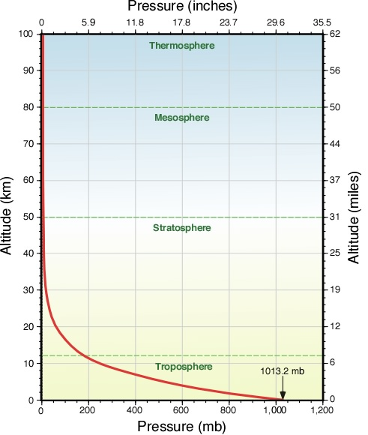
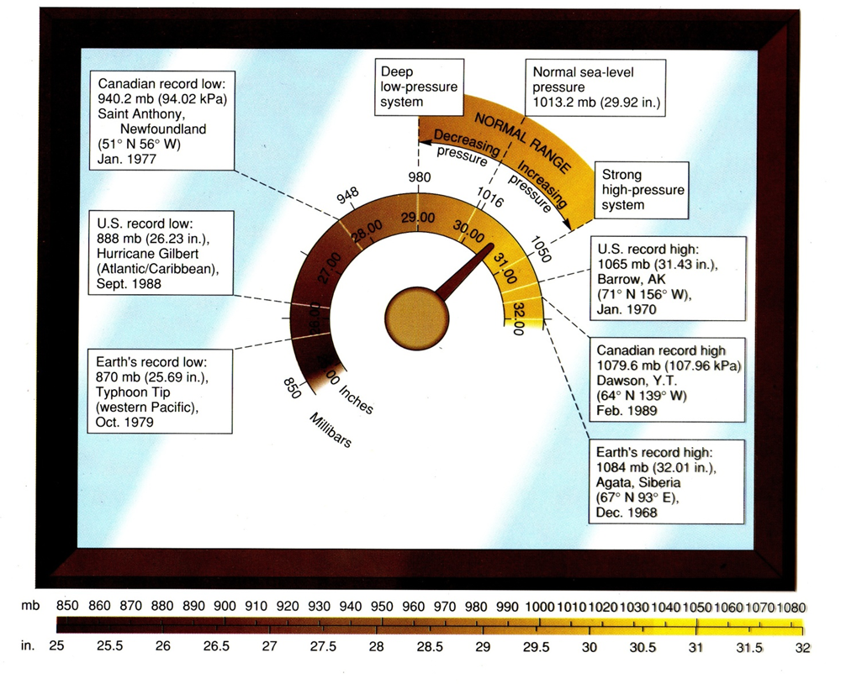
Air Pressure and Altitude
Air pressure is always changing, but meteorologists consider pressure at the surface, also known as “sea level pressure”, to be 1013 millibars (also known as 1 atmosphere).
Above the surface, pressure drops continuously all the way to outer space.

Slide 5
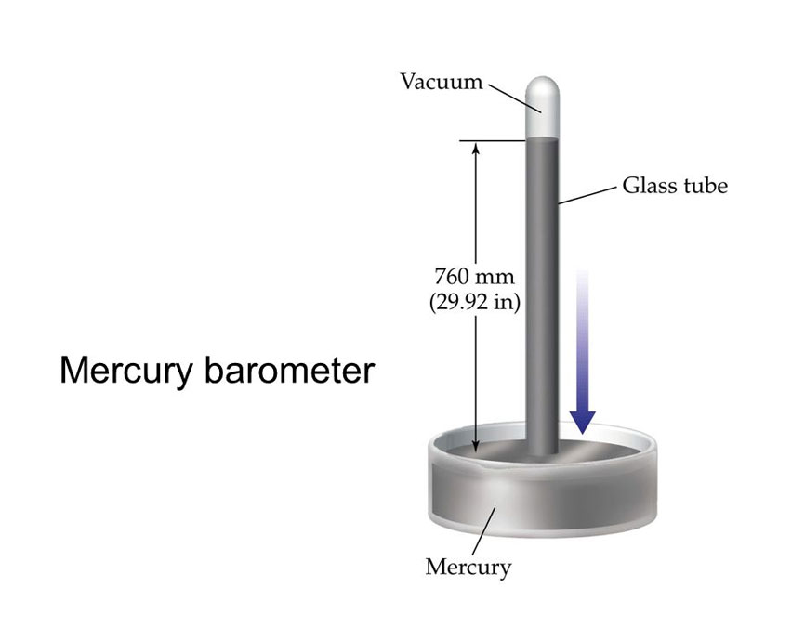
How to Measure Air Pressure
Air pressure is usually measured using a barometer, which is a device that measures the force of the air above a defined area. There are several types:
1. Mercury barometer
29.91 inches mercury = 1013 mb

Slide 6
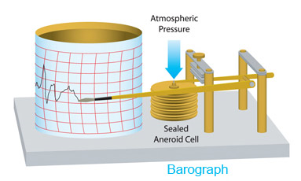
How to Measure Air Pressure
Air pressure is usually measured using a barometer, which is a device that measures the force of the air above a defined area. There are several types:
2. Aneroid barometer

